Slide 1
Digital Earth GEOG-104 Week 1: Definition of Map
Yi Qiang

Slide 2
Map
What is map?
Why we need map?

Slide 3
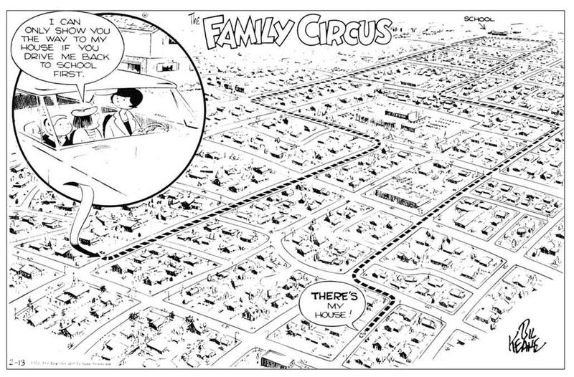
Mental map
As a child, mental map is a self-centered view of the world in which you related everything to your own position.
It can be the route from your home to school or playground.

Slide 4
Mental map
As you gain more knowledge your view becomes geocentric, which allows you to describe and determine:
locations
distances
directions
This visualization of space is based on Euclidian geometry
E.G. parallel lines never cross
the shortest distance is a straight line
that space is three-dimensional

Slide 5
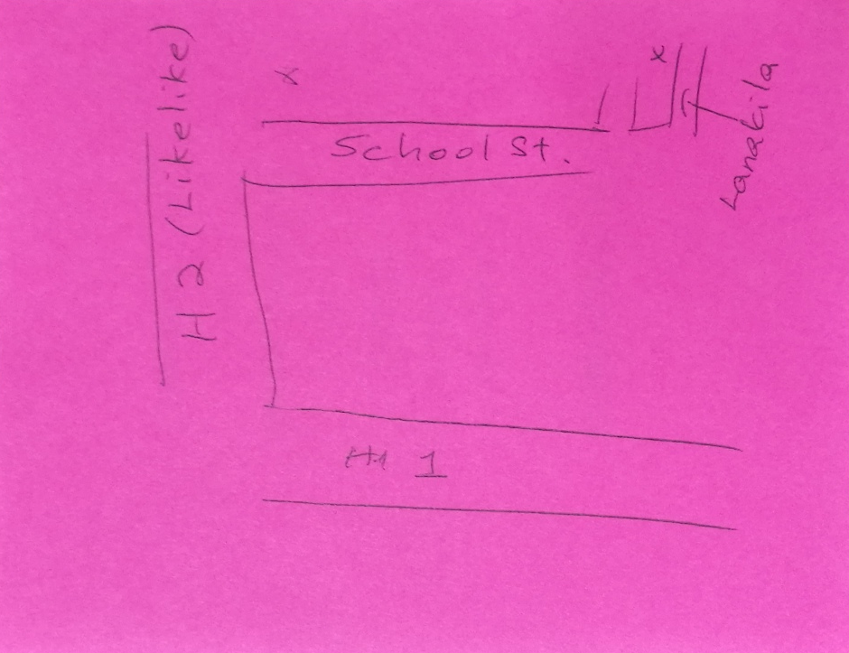
Mental map

Slide 6
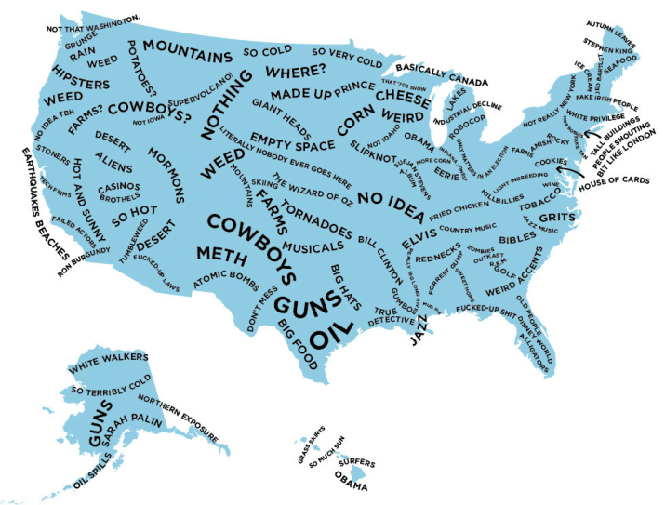
Mental map
Not only locations, but also what are at the locations

Slide 7
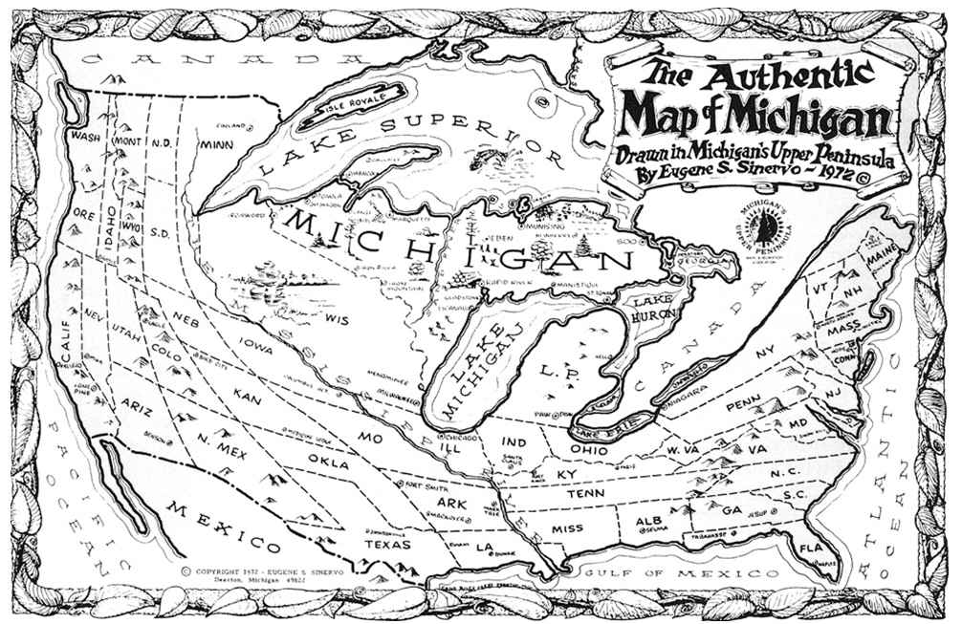
Mental map
It's difficult for most people to transform their mental map in a geometrically accurate manner.

Slide 8
Cartographic Maps
Cartographic map is a graphic representation of the environment
Vertical or oblique views of the environment
Created at a reduced scale
Created on a projection surface (in a 2D space)
Are generalized representations of the environment
Have symbols that represent the environment

Slide 9
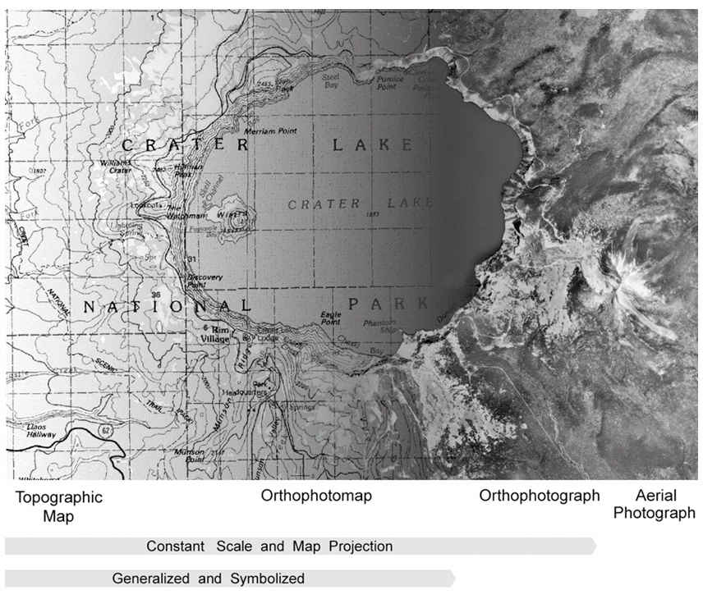

Slide 10
Functions of Maps
Reference maps
Thematic maps
Navigation maps
Persuasive maps

Slide 11
Reference maps
Symbols are used to represent geographic locations of natural and cultural features.
Different types and hierarchical levels of symbols for different features
Natural features include: mountains, valleys, plains, lakes, rivers, and vegetation
Cultural features include: roads, boundaries, buildings, and transmission lines

Slide 12
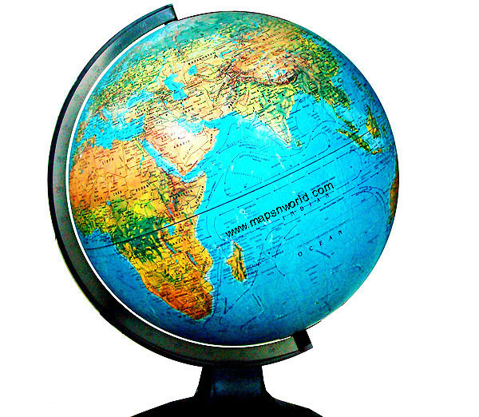
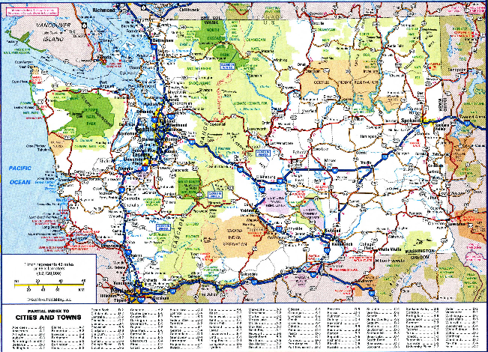
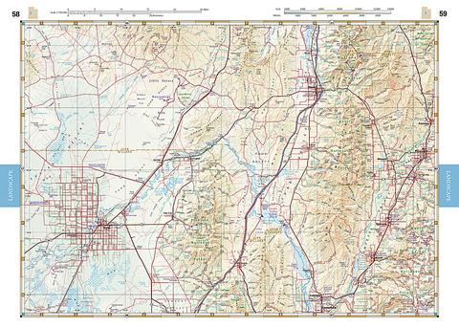
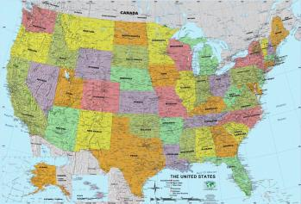
Reference maps
Examples are:
A world globe
Oregon State highway map
A Terra Grande US wall map
Utah road and recreational map

Slide 13
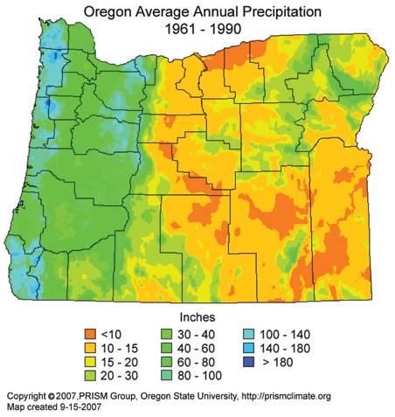
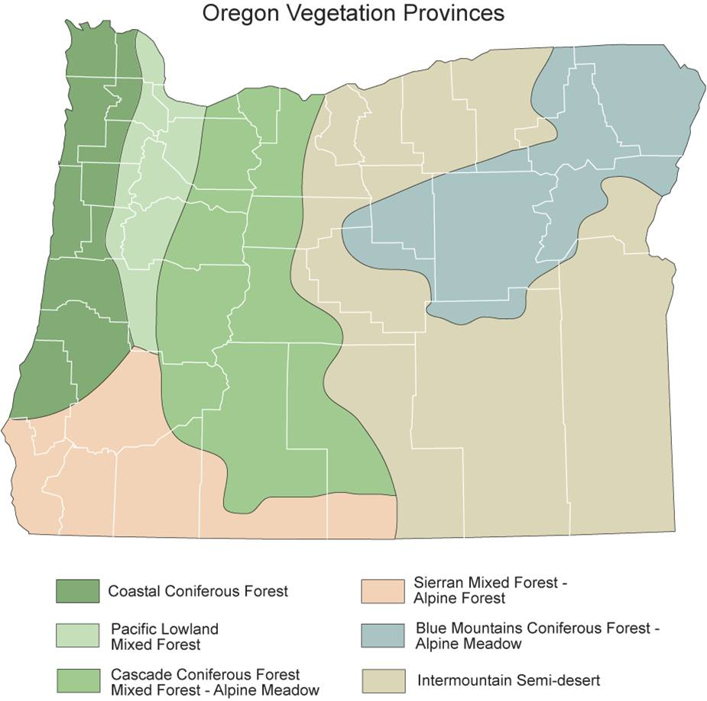
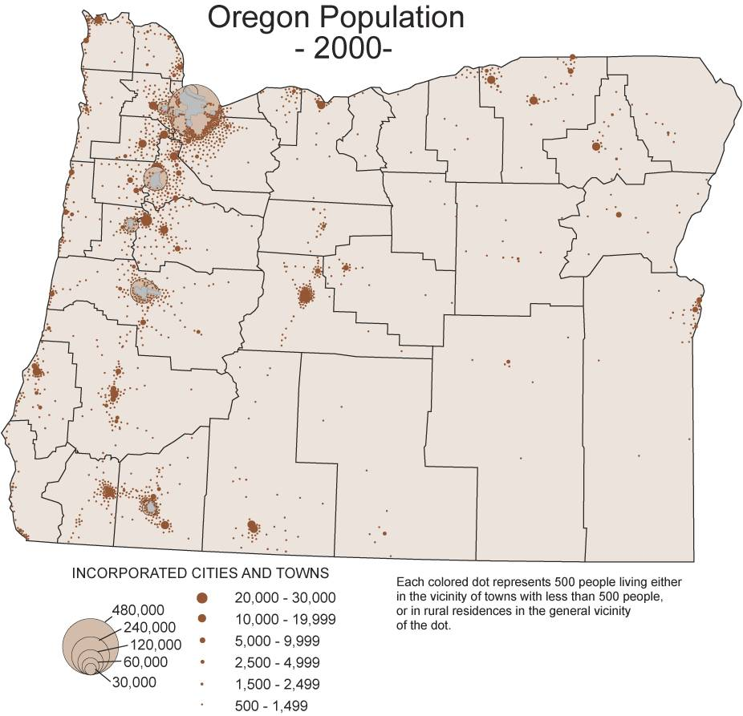
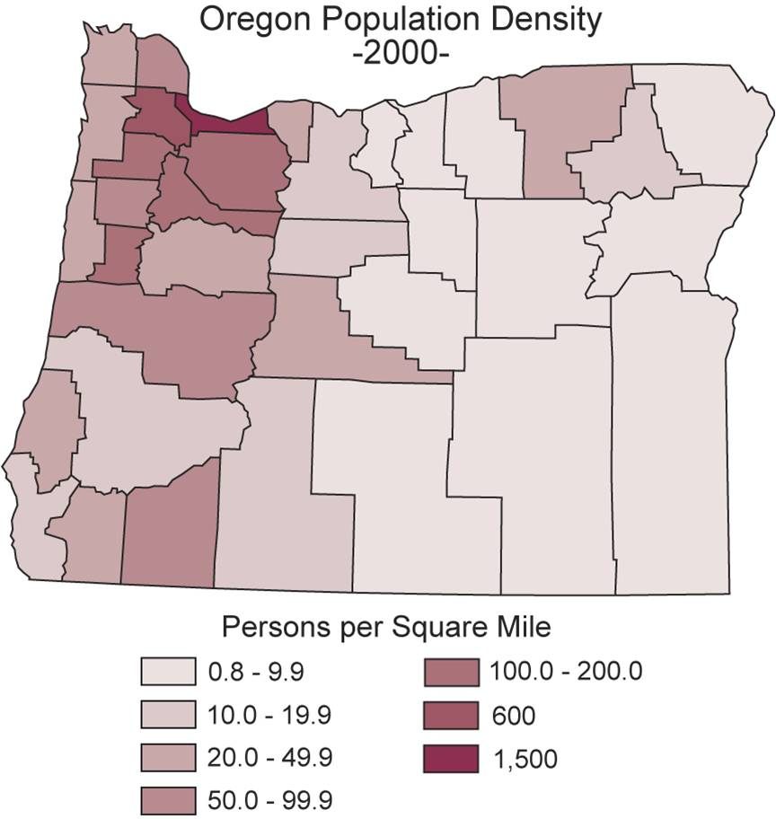
Thematic maps
Thematic map emphasize on geographical distribution of a specific theme (variable).
The theme may not be physically exists on the Earth surface – it can be an index, statistics or aggregation of geographical features.

Slide 14
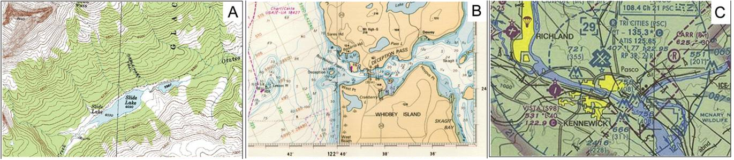
Navigation maps
Created specifically to help the navigators plan voyages and follow the planned travel route.
Topographic map nautical chart aeronautical chart

Slide 15
Persuasive map
Used in decision making and propaganda
To persuade you to choose a particular product or support a certain position.
May distort, exaggerate, or misrepresent the reality.

Slide 16
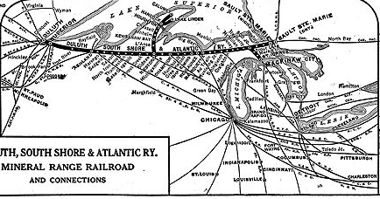
Persuasive map

Slide 17
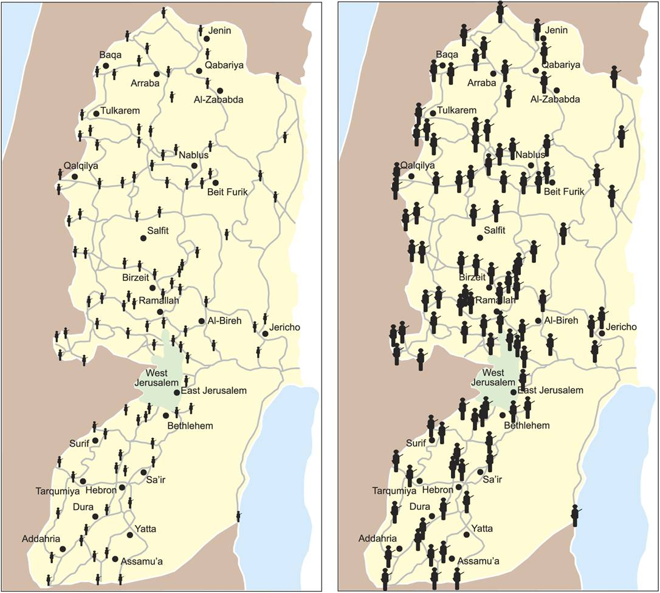
Persuasive map

Slide 18
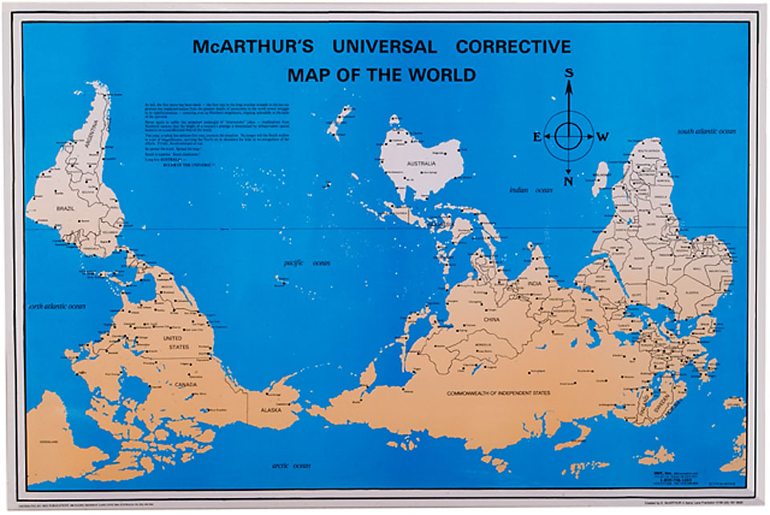
Persuasive map

Slide 19
What makes maps popular?
Maps function as media for the communication of geographic information.
Convenient to use
Simplification of our surroundings.
Credible
Has strong visual impact

Slide 20
Warning!
Simplicity means details are left out
You should question the credibility of maps
Some map features are;
distortions
others are errors
still others have been omitted by oversight or design
Maps are like statistics..... people can use them to show whatever they want.

Slide 21
Digital maps
Digital maps are based on digital representation of the world
Every item of useful information about the Earth’s surface is ultimately reduced to some combination of 0s and 1s
Digital representations is easy (fast and low-cost) for storage, transfer and processing
The fundamental question is how to represent the atomic elements of the geographic world: space, time and attributes

Slide 22
Representation of Space
The two fundamental ways of representing space are discrete objects and continuous fields.
The discrete view: the world is empty, except where it is occupied by objects with well-defined boundaries that are instances of generally recognized categories, for instance, a house, a lake, a car or a people on the Earth surface.
An discrete object can be represented as a point, lines, or polygon, or polyhedrons (3D)

Slide 23
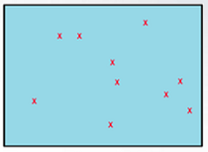
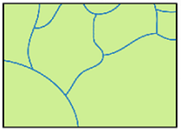
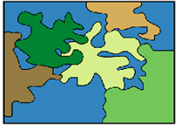
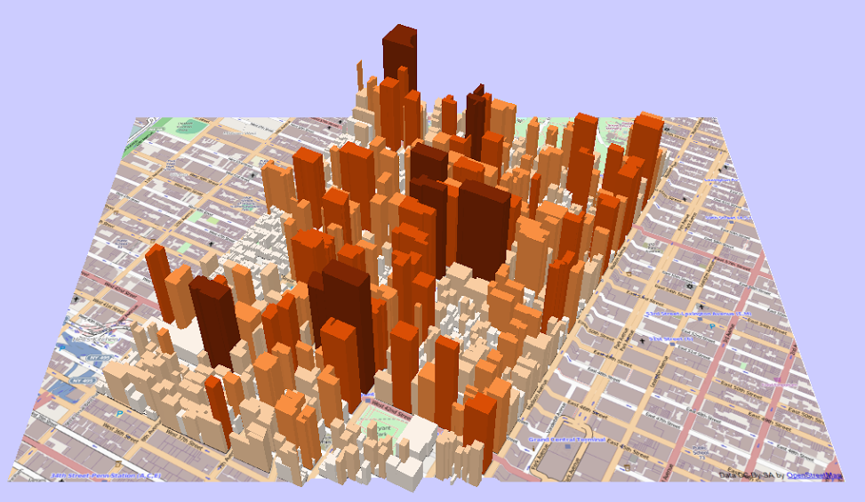
A discrete world
Points
Lines
Polygon
3D polygons

Slide 24
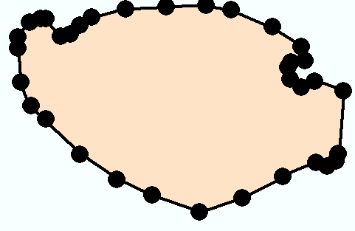
Representing discrete objects in vector data
Vector object is formed by points or series of points
Polygon
Vertices
Line
Points
Nodes
Y
X

Slide 25
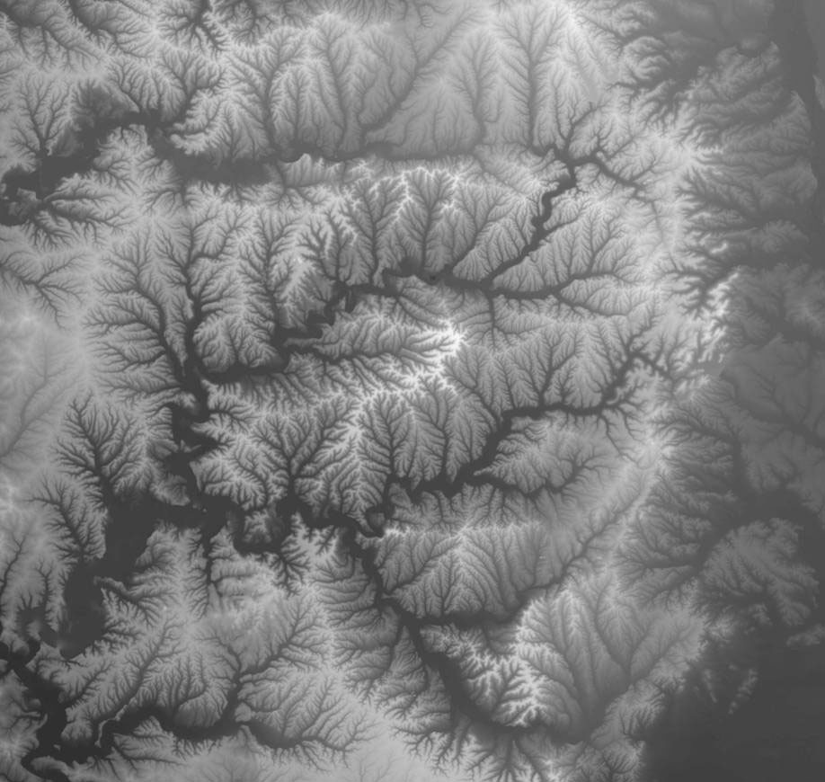
The continuous view
The continuous view represents the real world as a finite number of variables, each one defined at every possible position.
The continuous view is good at representing geographic processes with gradual changes (no clear boundary)
Digital elevation data

Slide 26
The raster data model
X, Y location
X, Y location
Columns
Rows
Raster data file
N rows by M columns
Georeferenced to earth’s surface

Slide 27
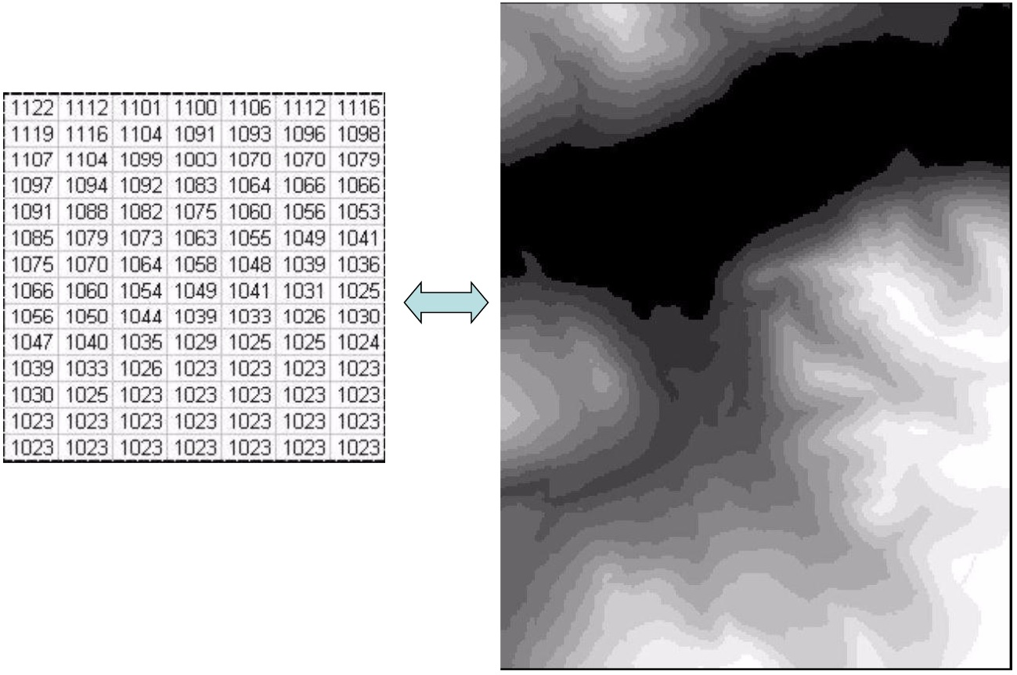
Digital elevation model (raster)

Slide 28
Raster and Vector Data
Raster data are described by a cell grid, one value per cell
Vector
Raster
Point
Line
Zone of cells
Polygon
Notes:
DRM

Slide 29
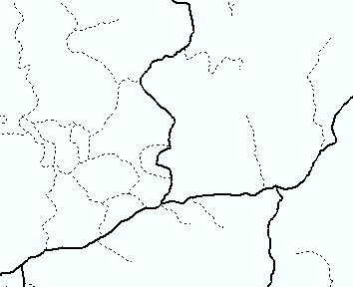
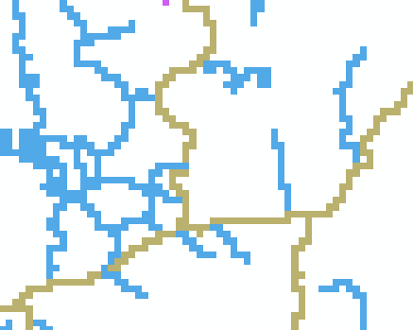
Raster and Vector Data
Vector model
Raster model

Slide 30
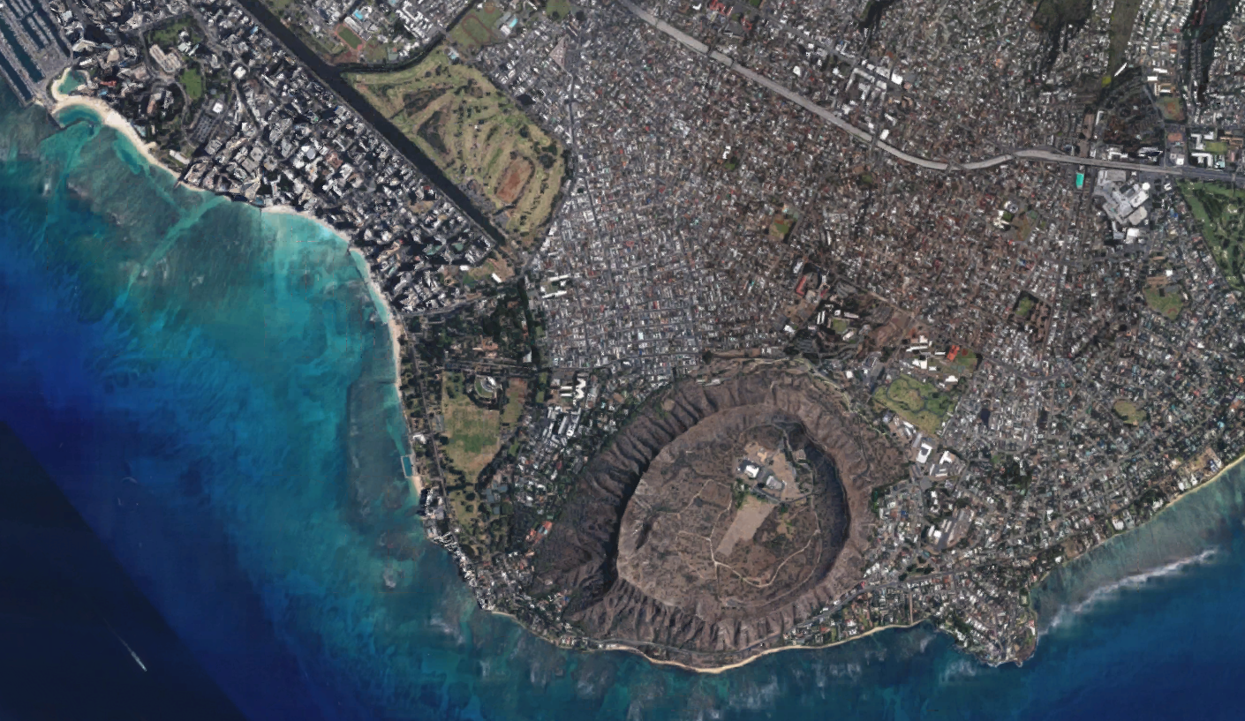
Continuous or discrete?

Slide 31
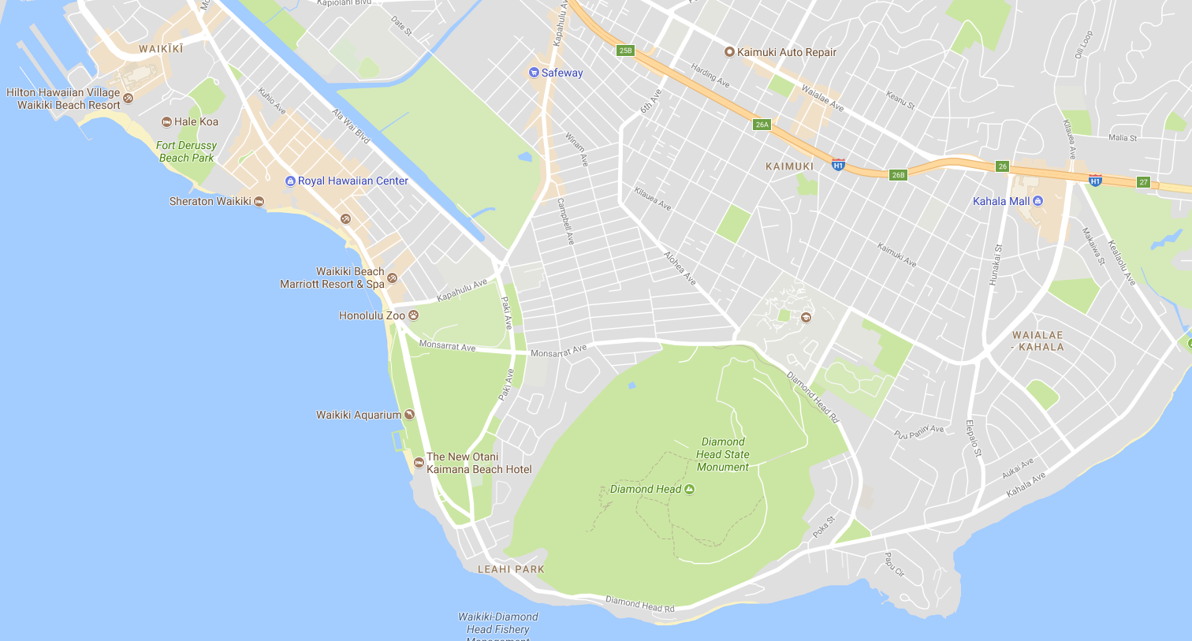
Continuous or discrete?

Slide 32
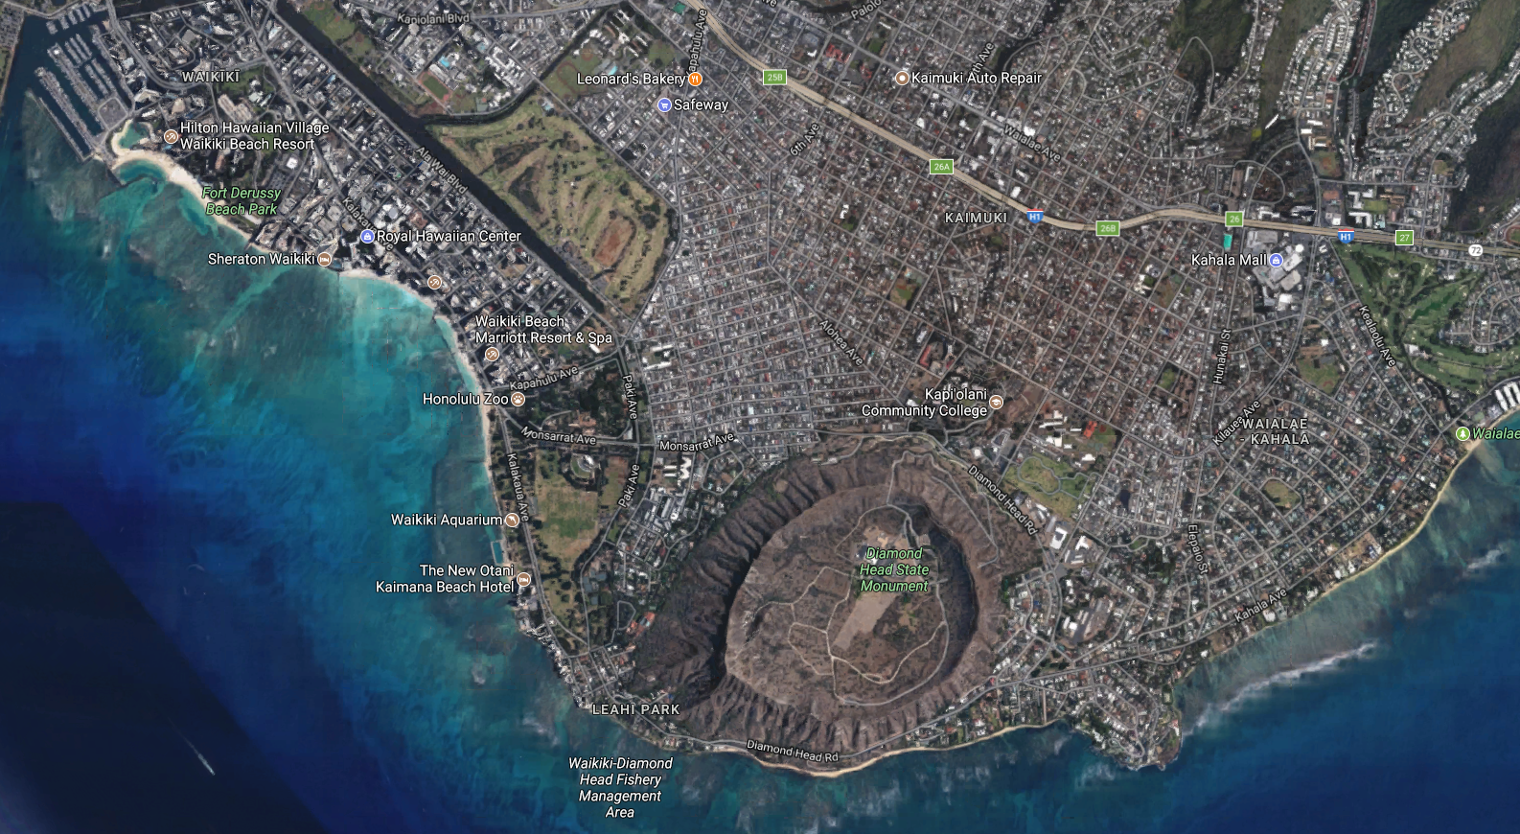
Continuous or discrete?

Slide 33
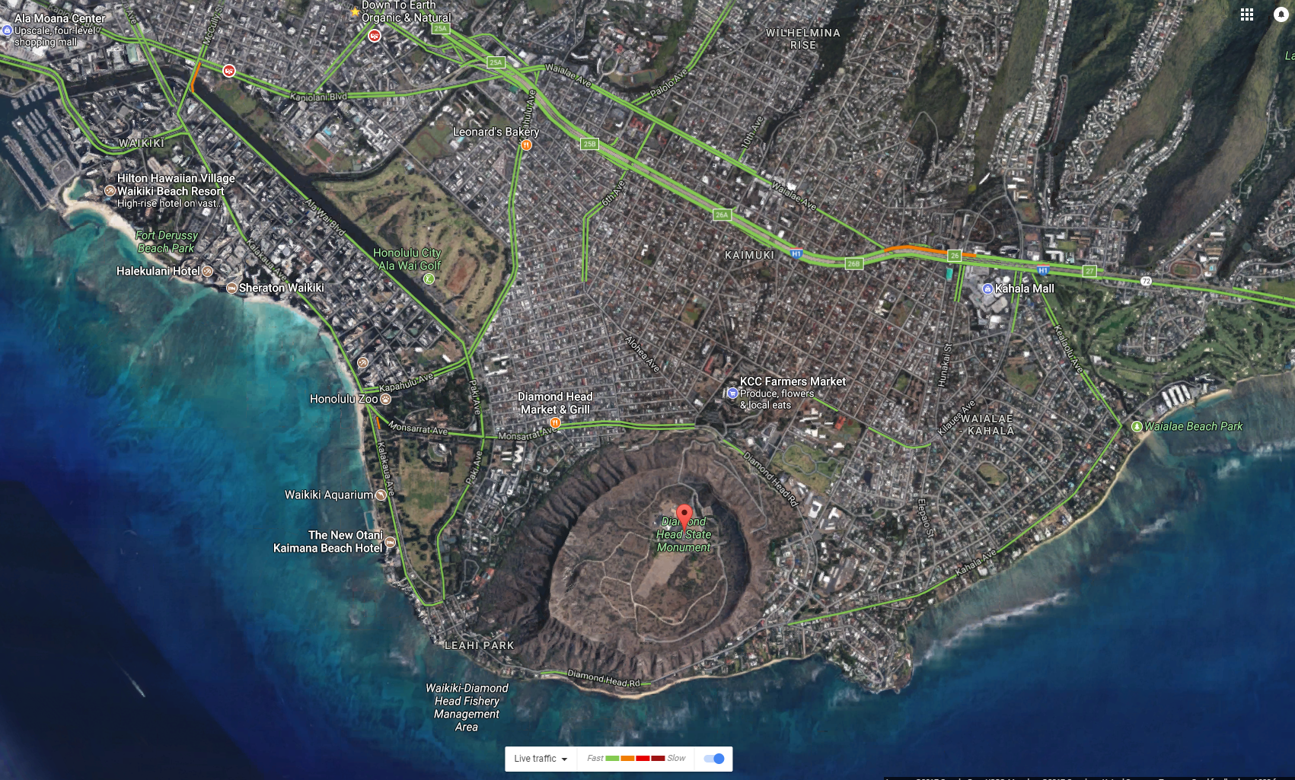
Power of digital representation
Overlay of multiple map layers

Slide 34
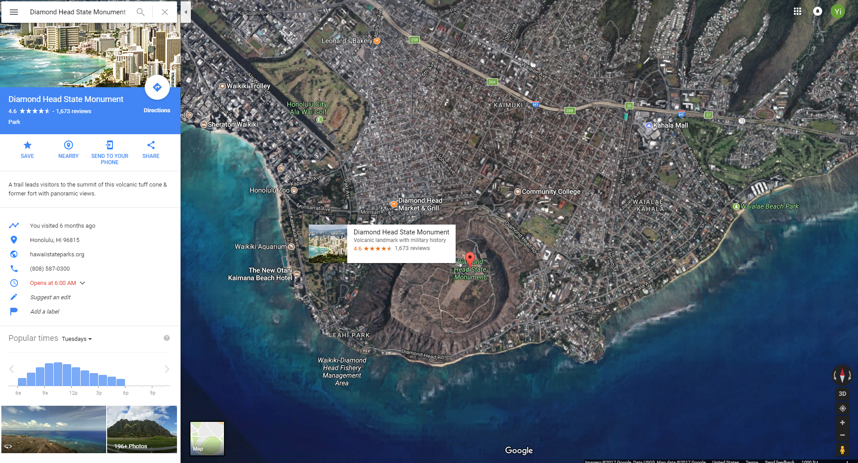
Power of digital representation
Interactive information display

Slide 35
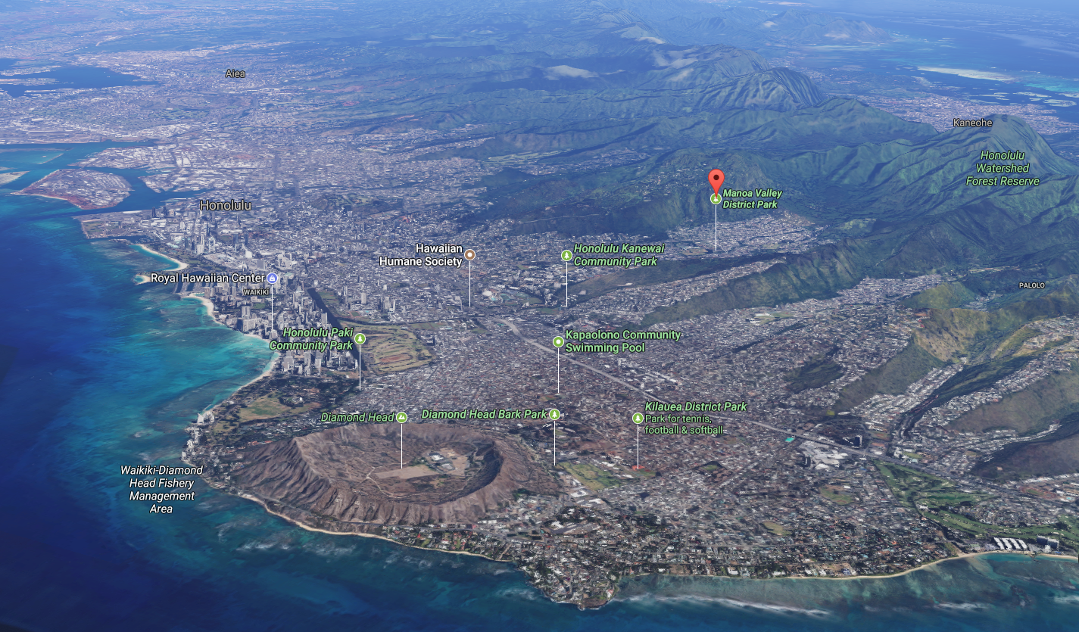
Power of digital representation
It can be 3D

Slide 36
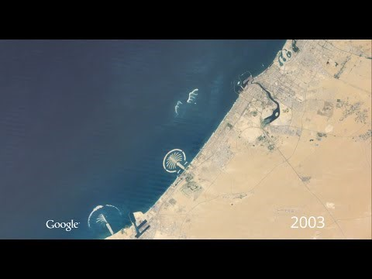
Power of digital representation
It can be dynamic (4D, including the time dimension)

Slide 37
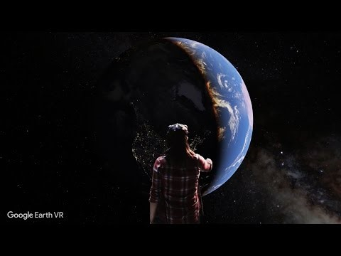
Power of digital representation
more than 4D – virtual reality

Slide 38
Week 1 Home Work
Write a short essay (1-page) describing how you envision maps in 2100. You can describe:
How they looks like
What technologies they use
How do people use them
How do they change our lives and view of the world
The above are some examples - you can write what ever you come up with.
Submission through Laulima in MS Word or PDF format. Use your name in the file name (e.g. Yourname_HW1.docx)

